Slide 1
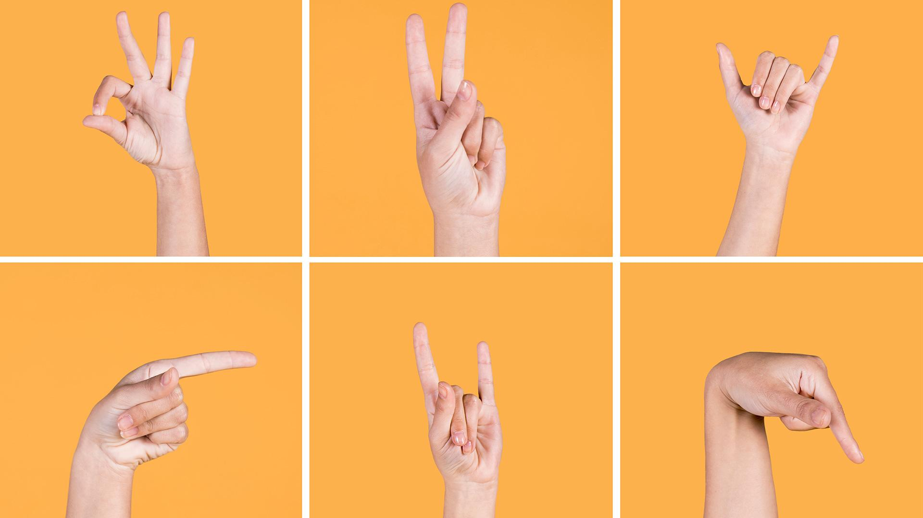
Sign Language Using Ai
Under OF Supervision
Dr:Ahmed Gaber
Eng:Sama Ayman

Slide 2
Agenda
Problem Statement
Proposed Solution
Designing for Usability (UI/UX)
Front-End Overview
AI Models (Machine Learning & CNN)
Back-End & APIs
Future Work
Live Demo
Q&A (Questions & Answers)

Slide 3
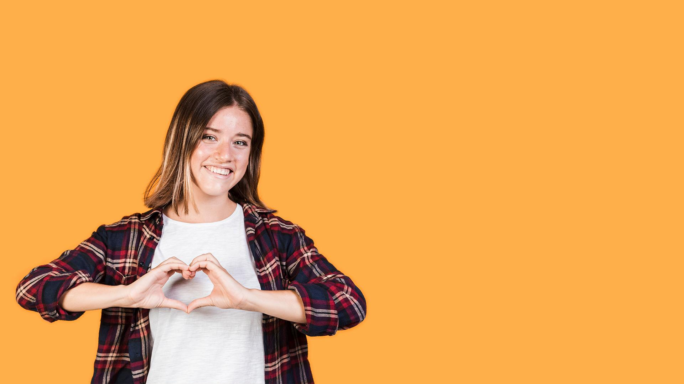
Problem Statement

Slide 4
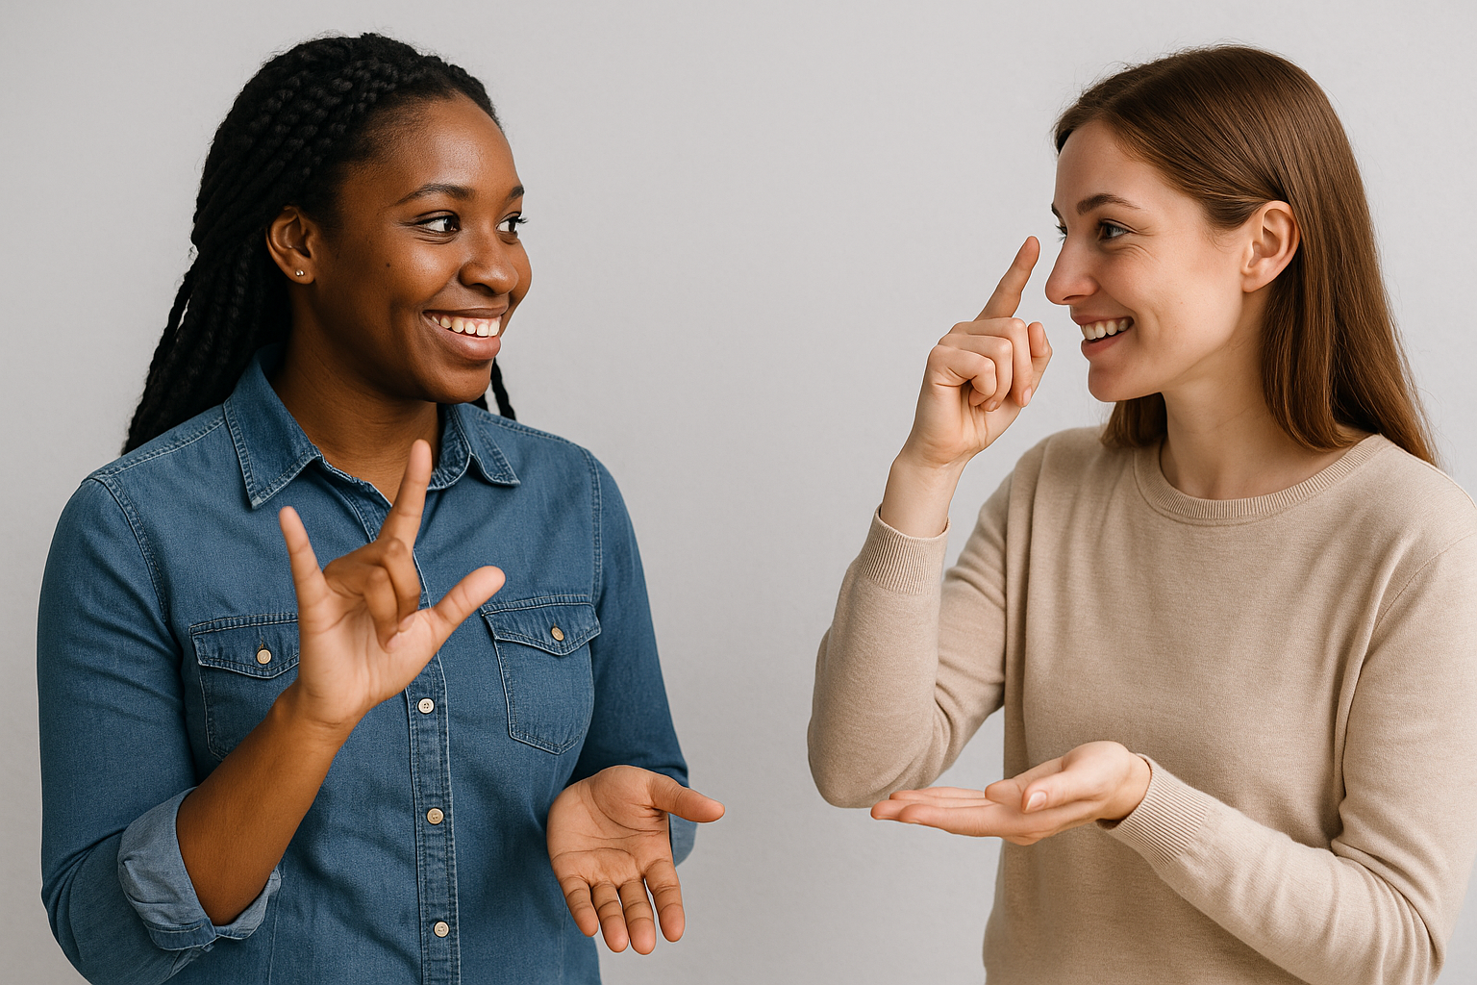
Problem Statement
Over 466 million people worldwide suffer from hearing loss.
Communication between deaf individuals and non-signers remains a major challenge.
Traditional solutions (e.g., human interpreters) are not always available or practical.
Many educational, social, and medical services are difficult to access for the deaf community.
There is a lack of real-time, AI-powered tools that can bridge this communication gap.

Slide 5
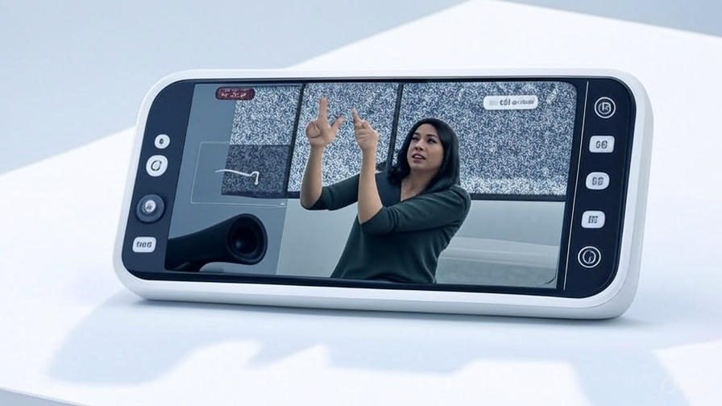
Our Proposed Solution
Develop an AI-powered web application to recognize sign language.
Use camera input to detect hand gestures in real-time.
Apply image-based detection using deep learning (CNN models). Enable both real-time video and static image inputs.
Design a clean, accessible user interface for all users.

Slide 6
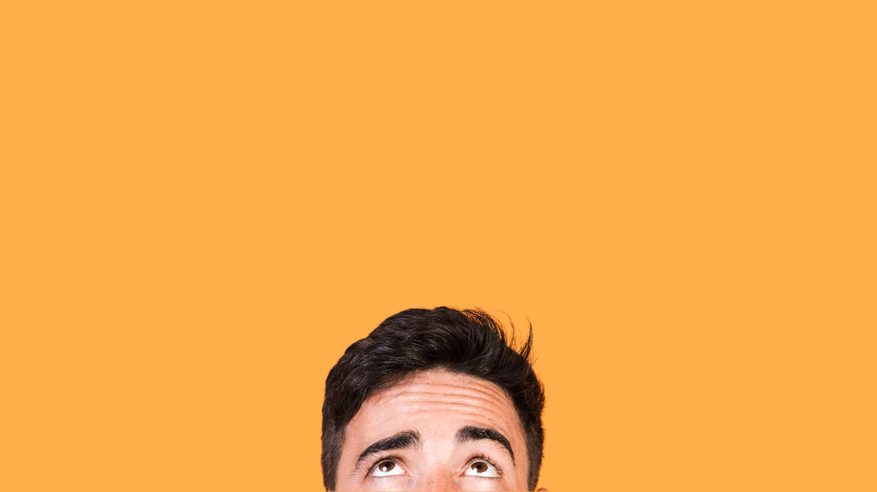
01 SECTION
From Idea to Interface: The Power of UI/UX

Slide 7
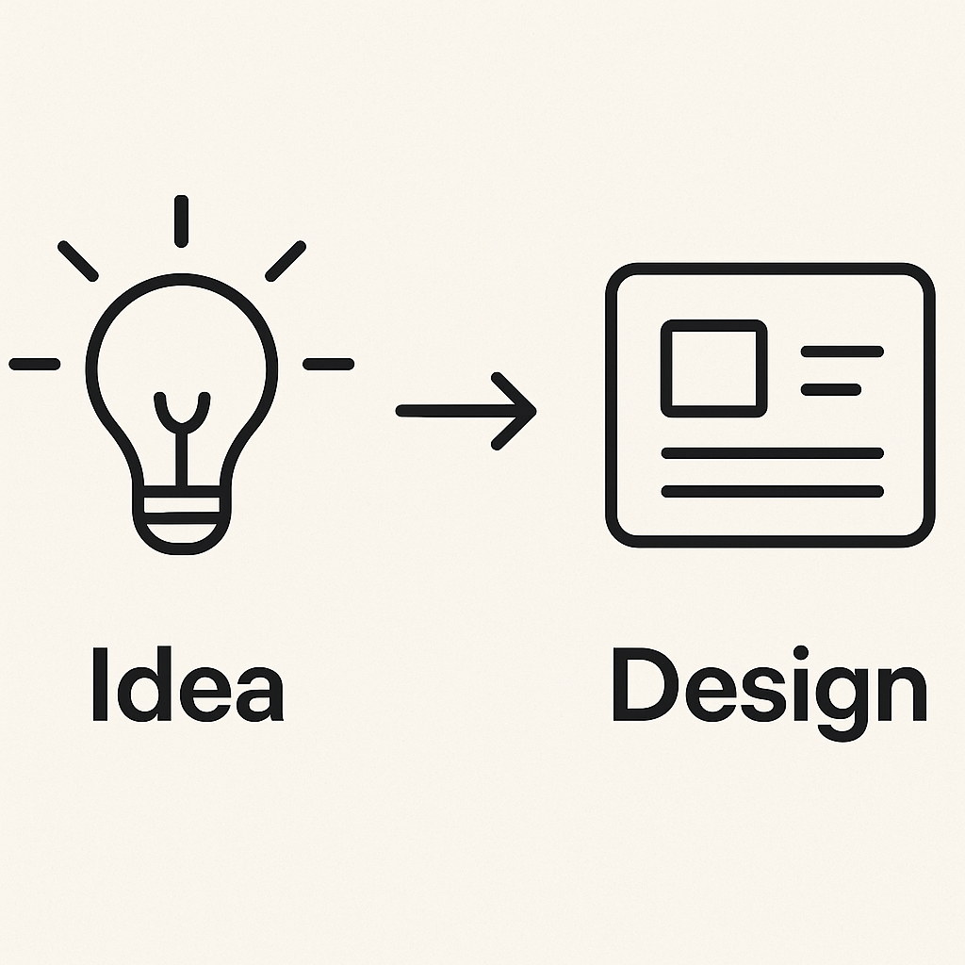
UI/UX Design – Overview
"I was responsible for designing the complete user interface and experience of the application."
"To make the system easy, accessible, and user-friendly, especially for the deaf community."
"I started by identifying user needs, then moved to wireframes, user flows, and finalized the UI using Figma."
"A great model is not enough — if the user can’t interact with it smoothly, the system fails. That’s why we focused on intuitive and responsive design."

Slide 8
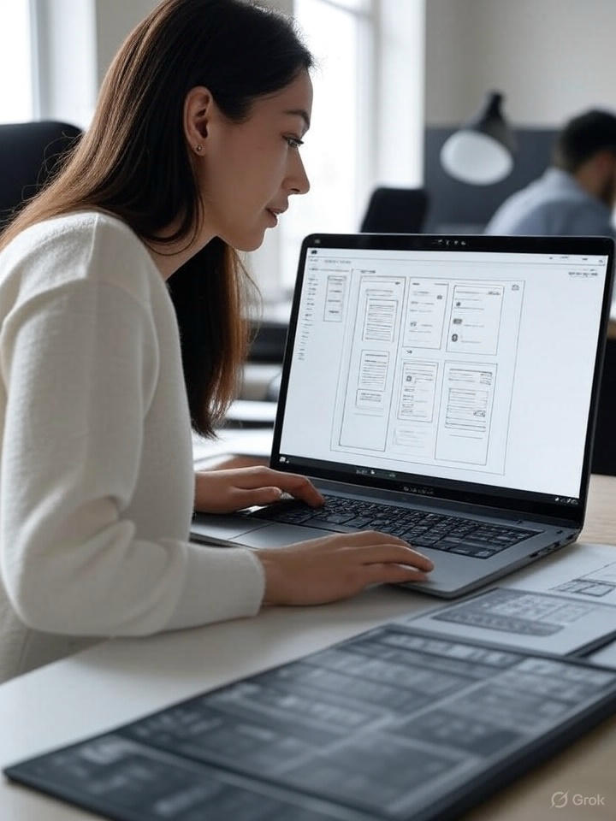
The UI/UX Design Process
Collected user needs and requirements
Created wireframes to organize screen elements
Planned user flow from splash screen to result
Focused on user journey clarity and task efficiency

Slide 9
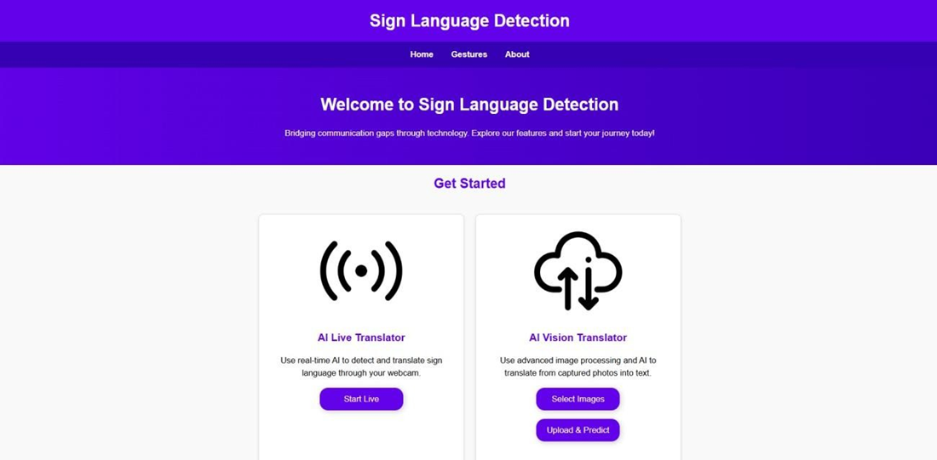
Turning User Needs into Design
Defined target users using personas
Created low-fidelity wireframes for screen layout
Created low-fidelity wireframes for screen layout
Built the final UI design using Figma
Focused on simplicity, clarity, and accessibility
Used Auto Layout for responsive and clean design

Slide 10

Tools & Final UI Implementation
Used Figma to build the final UI screens
Applied Auto Layout for responsive design
Chose readable fonts and soft colors for clarity
Focused on accessibility and user comfort
Tested design with users and applied feedback

Slide 11
02 SECTION
From Click to Action: The Front-End Engine

Slide 12
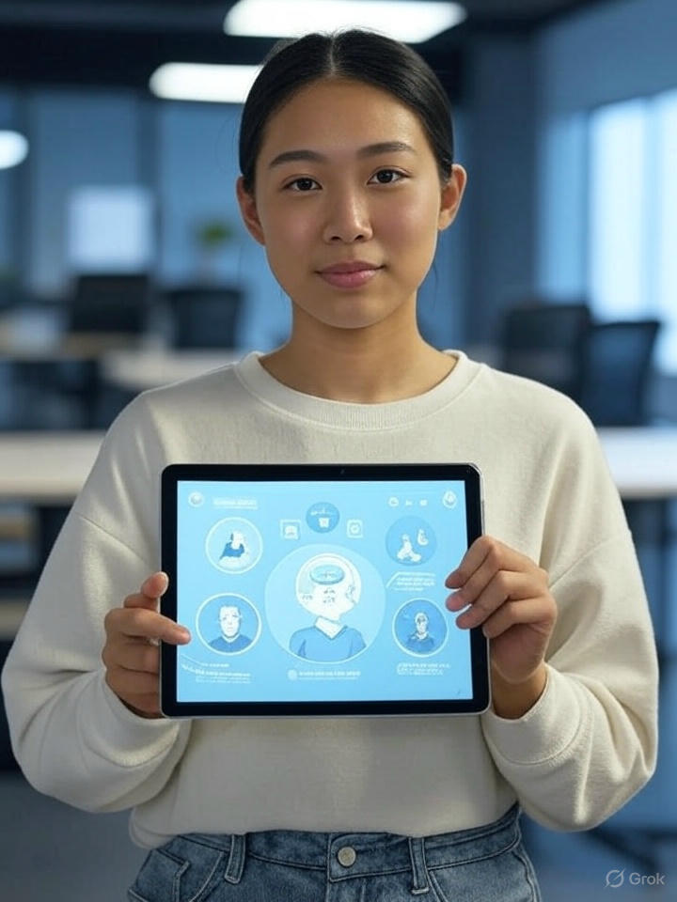
The Interface Engine: Target Outcomes
Set up the project structure
Integrate the frontend with backend APIs
Display translated output dynamically in the website views
Ensure smooth navigating through the website

Slide 13
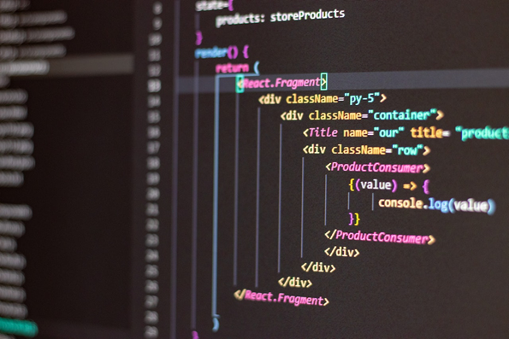
Tech Stack That Powered the Interface
●🔧 Angular – Component-based framework for SPA
●🟨 TypeScript – For scalable and strongly-typed logic
●🌐 HTML5 & CSS3 – To build structured layouts and responsive designs
●

Slide 14
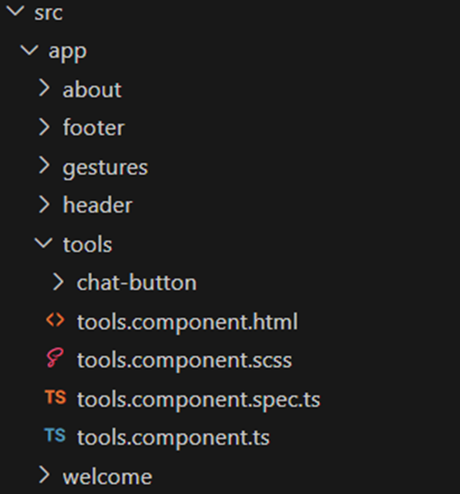
Modular & Scalable: Our Angular Component Architecture
/src/app/
├── app.component.ts // Root component
├── header/ // Top navigation
├── welcome/
├── tools/ // Main interaction controls
│ ├── chat-button/ // Chat-trigger button
├── gestures/
├── about/ // About project/help
├── footer/ // Bottom section of the UI

Slide 15
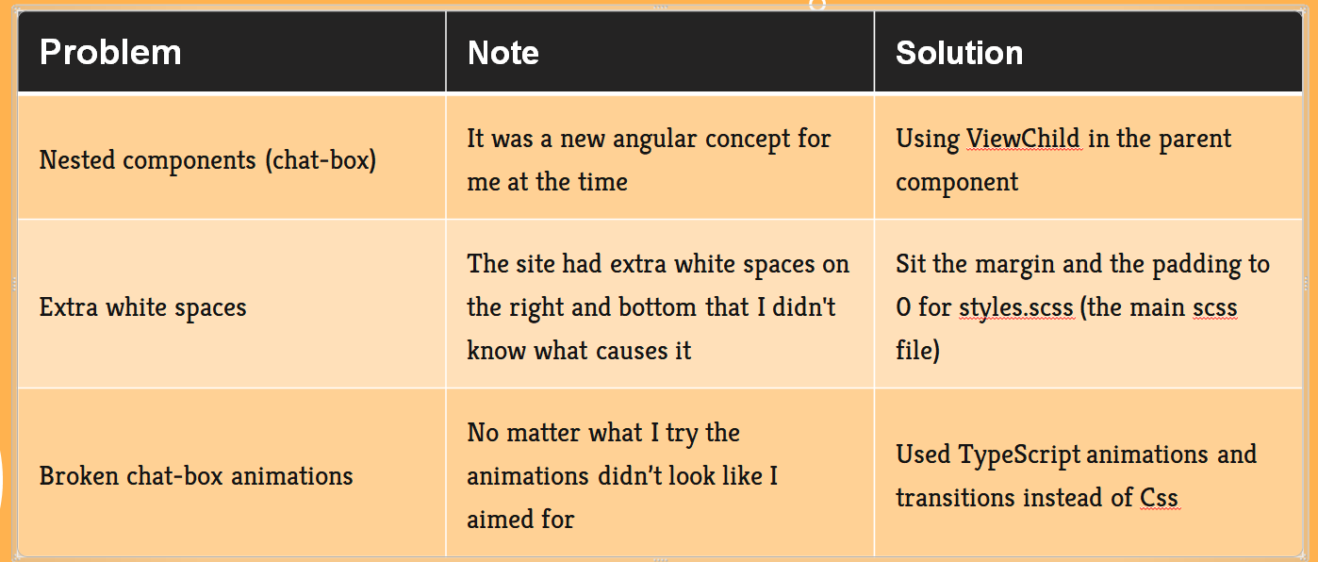
Development Hurdles – Layout & Structure

Slide 16
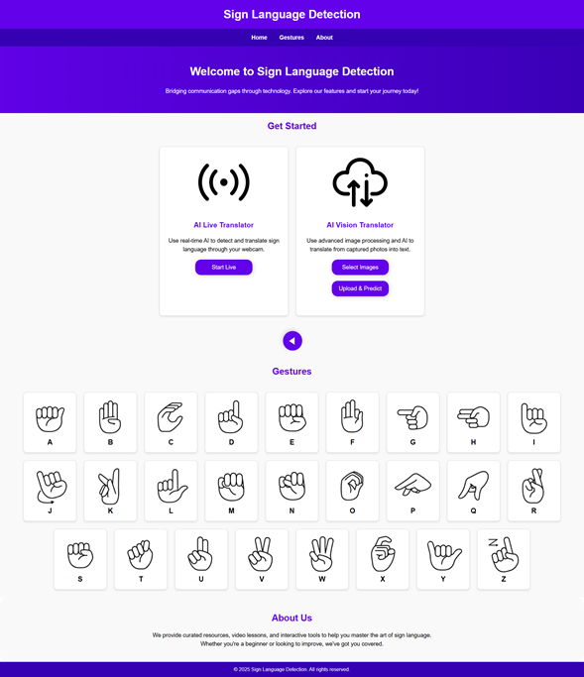
This Is What the User Sees

Slide 17
03 SECTION
Think Like a Human, Act Like a Machine – Our AI Layer

Slide 18
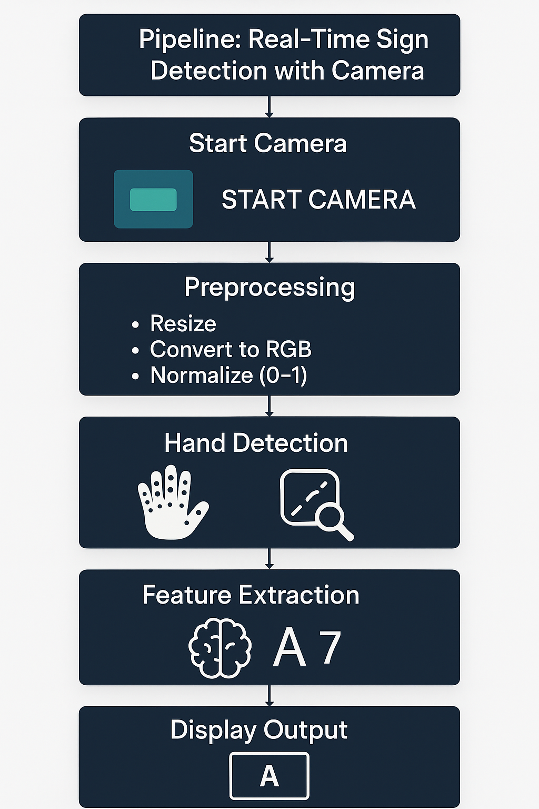
Real-Time Detection Flow – From Camera to Prediction
Camera Initialization
Color Conversion & Preprocessing
Hand Landmark Detection (MediaPipe)
Feature Exteraction
Prediction (Random Forest Model)
Classification for sign
Display Results on UI

Slide 19
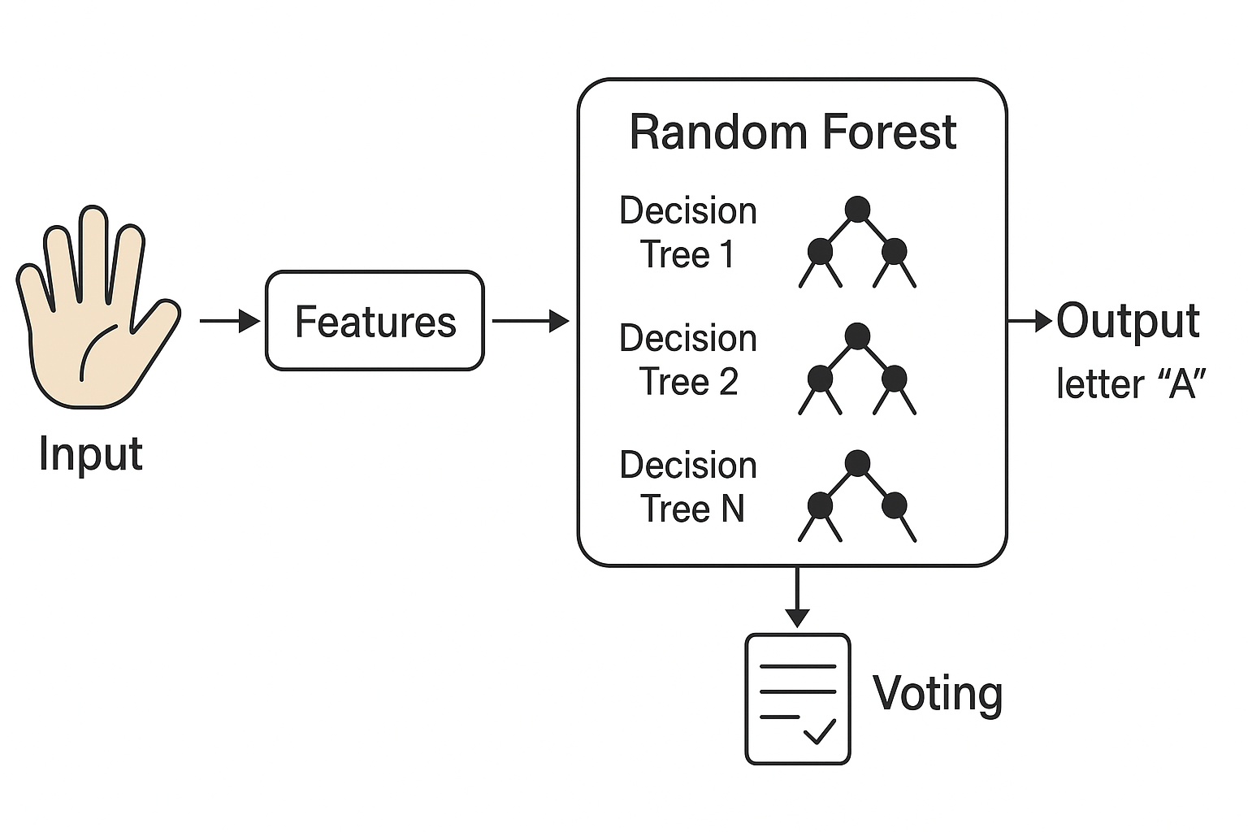
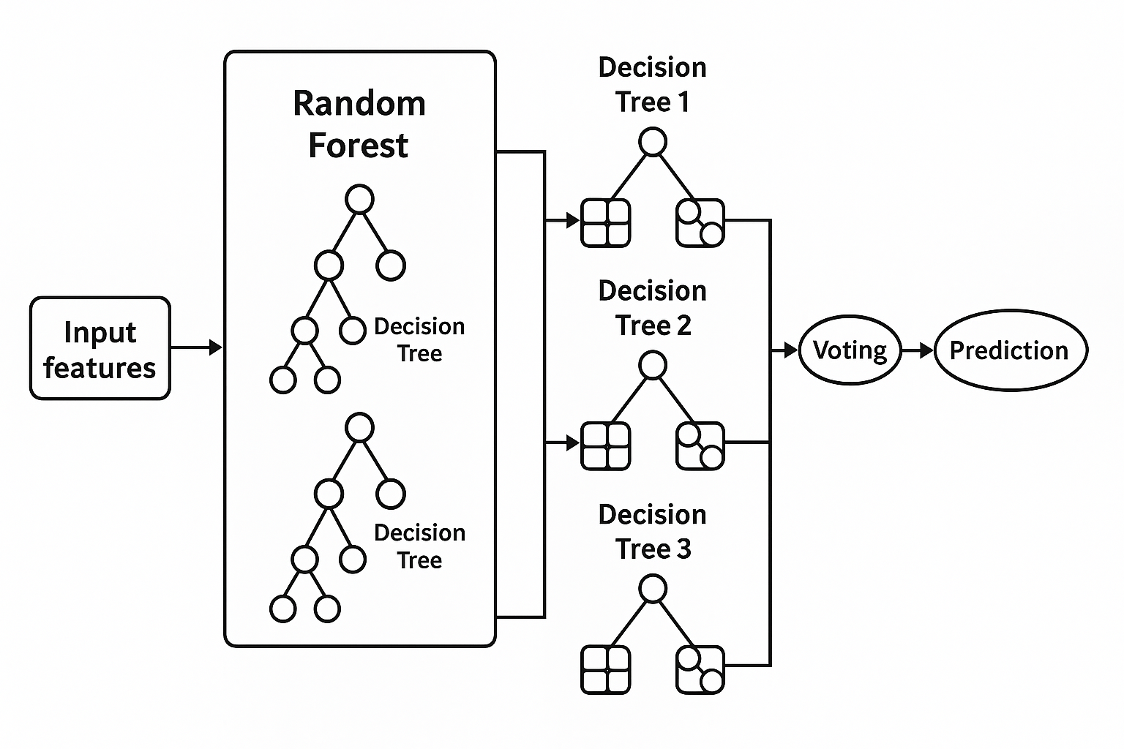
How Random Forest Understands Hand Signs
Bootstrapping (Random Sampling)
Random Feature Selection
How a Single Tree Works
Voting Mechanism
Why Random Forest Is So Effective

Slide 20
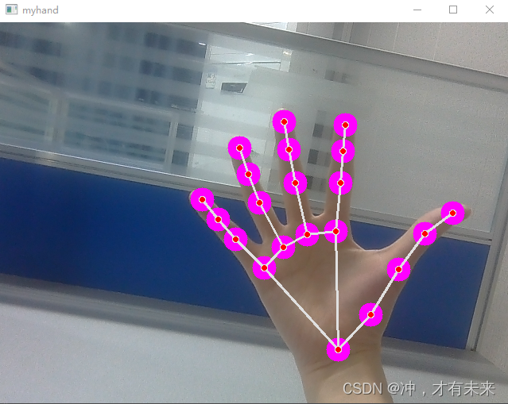
Why Random Forest + MediaPipe Worked So Well
Hand Detection & Tracking
Real-Time Performance
Data Preparation for AI Model
Why MediaPipe Was Ideal
Pre-trained & ready to use
Lightweight & fast
Accurate across different hand shapes
No need to train a separate hand detection model

Slide 21
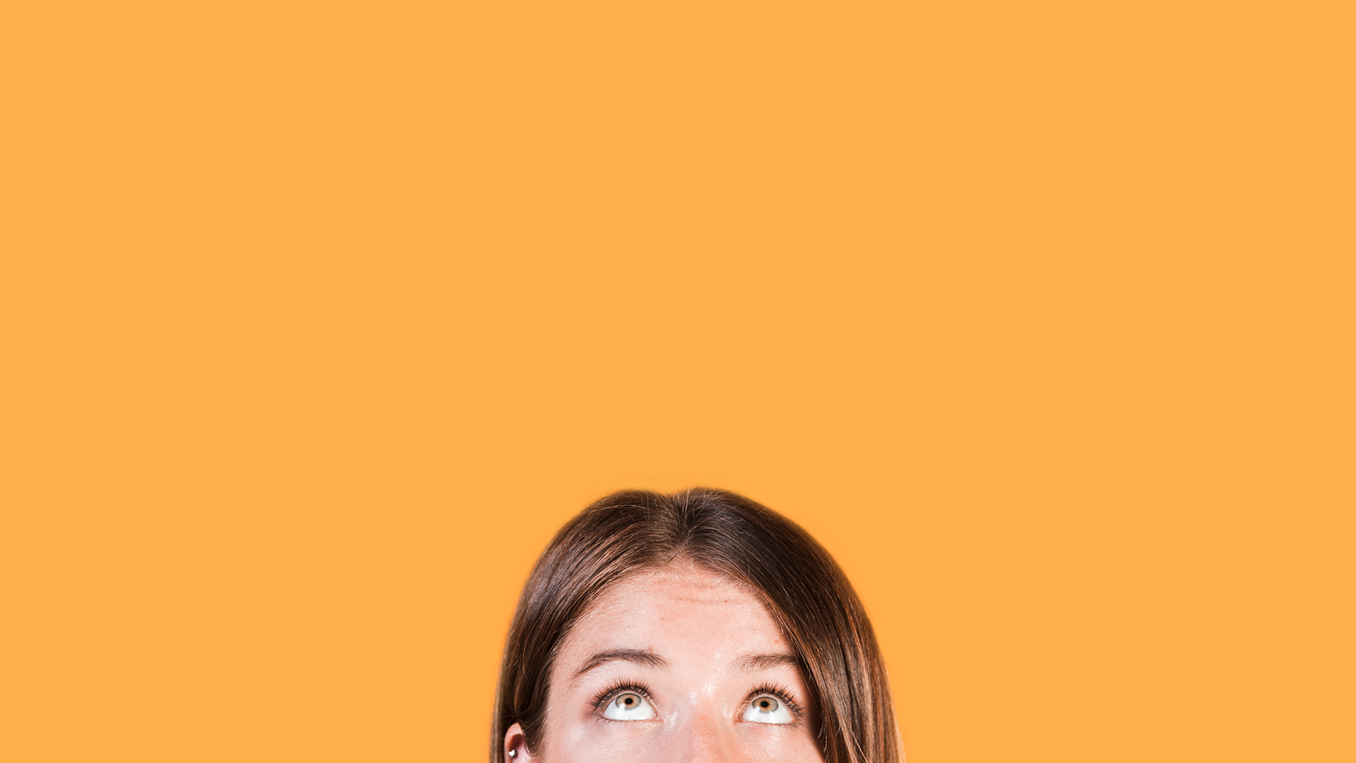
Model Performance and Results

Slide 22
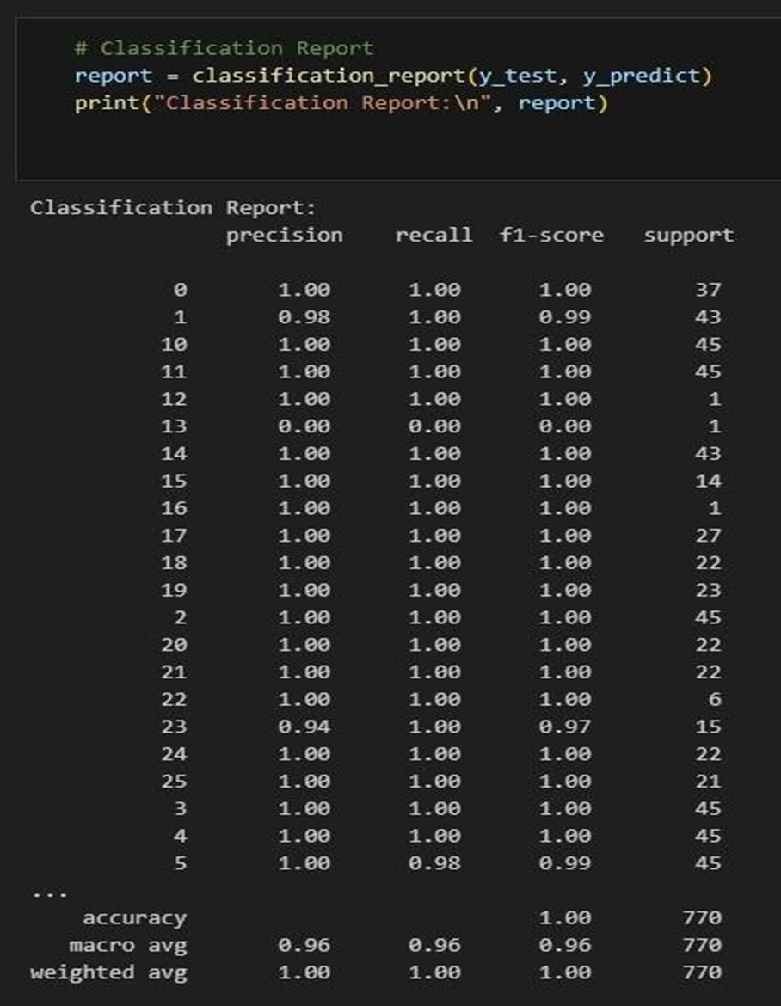
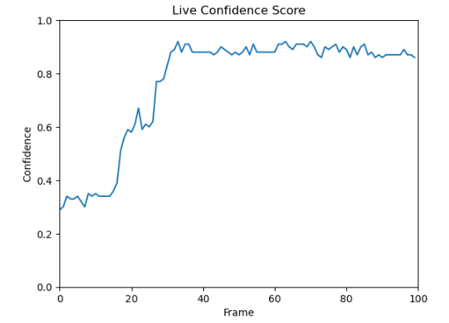
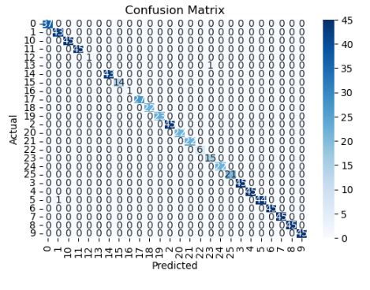
Final Evaluation: Is the Model Reliable?
Train Accurcy: 99.7%
Test Accurcy: 97.5%
Recall: 99.8%
Precision :99.5
F1-Score:99.8

Slide 23
Part 2: The Visual Brain – CNN for Hand Sign Recognition

Slide 24
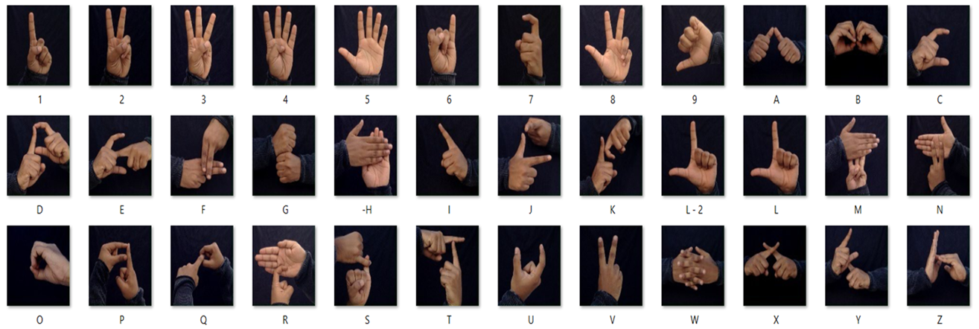
Model Training Overview – Vision Translator
Recognize static hand gestures from images
Translate gesture into readable letter or number
Indian Sign Language Dataset
Includes A–Z and 0–9 gestures
Clear hand positions with consistent dark background
Model: CNN
Input: 64×64 grayscale images
Output: Softmax layer (36 classes)
Optimizer: Adam
Loss: Categorical Crossentropy

Slide 25
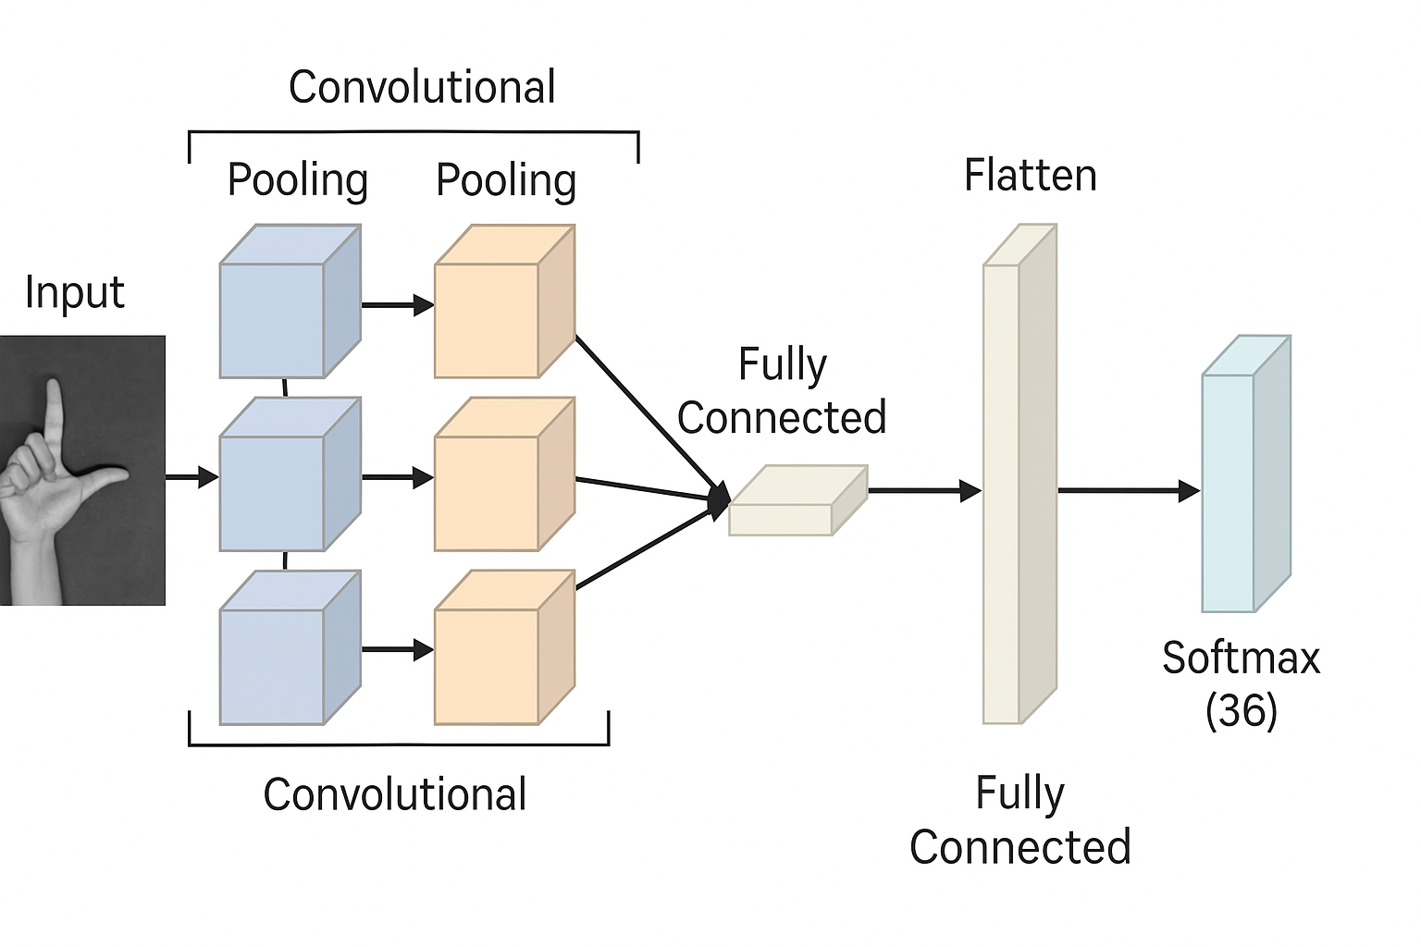
How It Thinks: CNN Model Architecture
Input Layer: 64×64 grayscale image
Convolution Layer 1 → ReLU
Max Pooling Layer
Convolution Layer 2 → ReLU
Max Pooling Layer
Flatten Layer
Fully Connected (Dense) Layer
Softmax Output Layer (36 classes)
Learns visual patterns (edges, curves, shapes)
Extracts hierarchical features layer by layer
Ends with classification into letters/numbers

Slide 26
Model Performance and Results

Slide 27
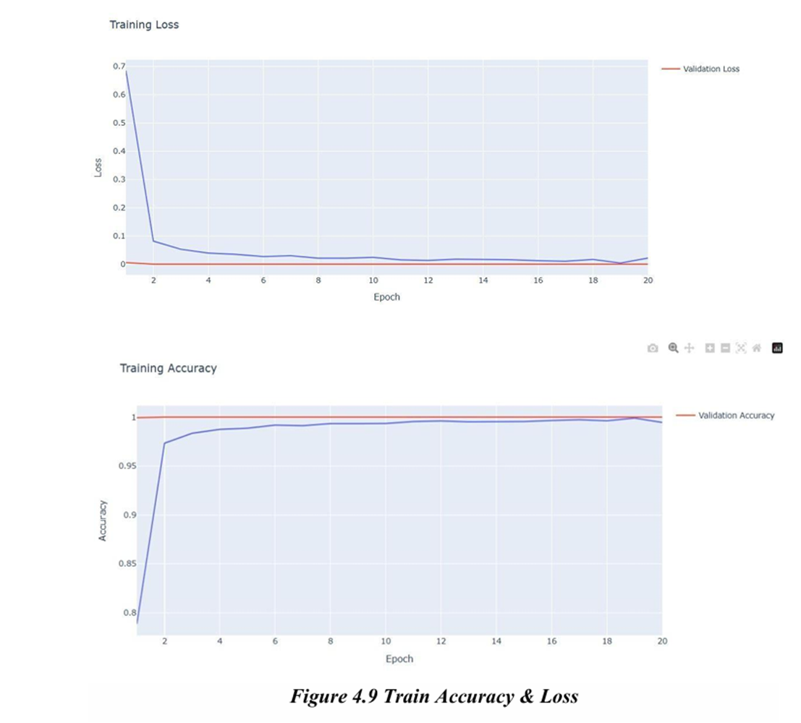
Overall Results:
Train Accuracy: 99%
Validation Accuracy :98.8%
Test Accuracy: 98.6%

Slide 28
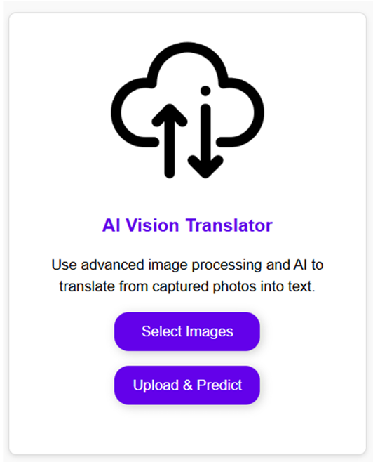
From Sign to Text: How the Model Works in Action
User selects a hand sign image via "Select Images" button
The image is uploaded to the backend
Backend preprocesses the image (resize, normalize)
The trained CNN predicts the gesture (A–Z or 0–9)
The prediction is returned and displayed as text
The final sentence is updated on the UI
Works with static gesture images
Fast prediction with minimal delay
Clean display of output in 'Final Sentence' section

Slide 29
04 SECTION
Behind the Interface: The Backend That Powers It All

Slide 30
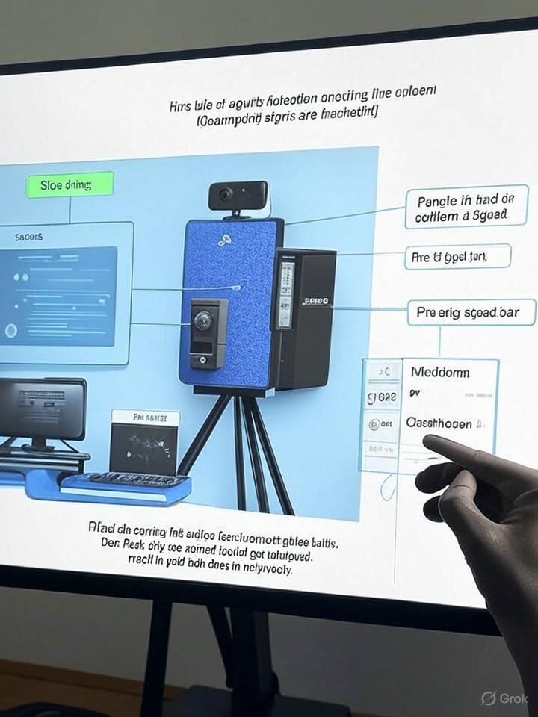
Real-Time Backend – Live Sign Detection via Flask
Initialized Flask server to stream live video from webcam
Loaded pre-trained model (.pkl) for real-time sign classification
Used MediaPipe to detect and track hand landmarks
Live prediction shown over video using /video_feed endpoint
Communicates directly with frontend via Flask API
Tools & Libraries:
Flask
OpenCV (cv2
MediaPipe
NumPy

Slide 31
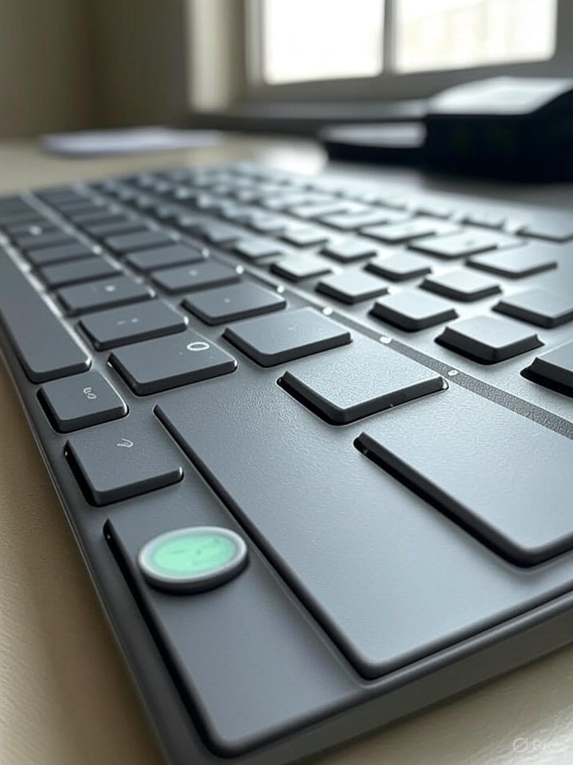
Interactive Live Session – Keyboard Control System
S – Add space between words
K – Save current letter
D – Delete last character
P – Print final sentence
Q – Quit live session
1-This improves usability for fast interaction
2-Designed to support deaf or mute users with full sentence construction

Slide 32
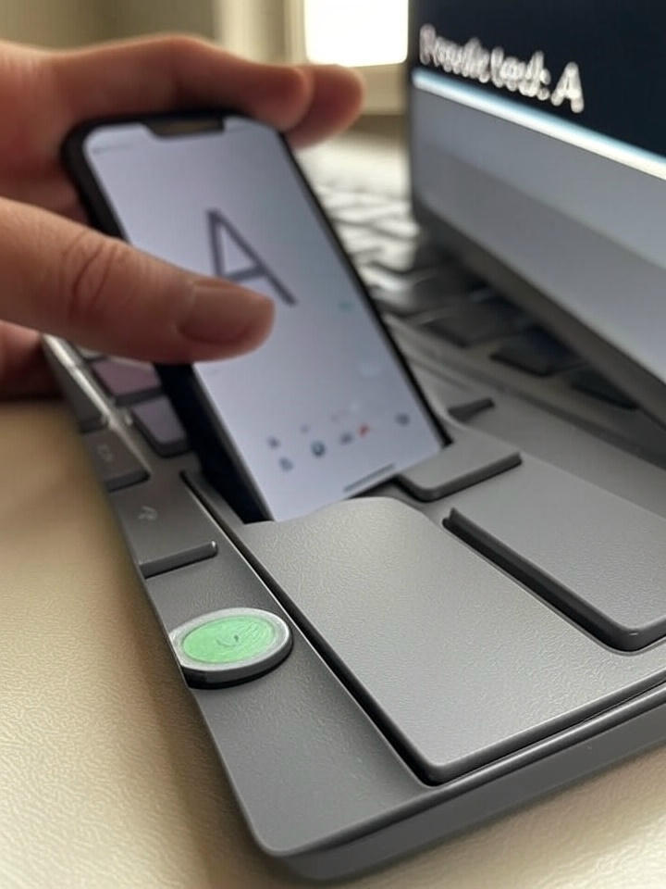
Static Image Recognition – Flask Prediction API
Accepts uploaded gesture images via POST (/predict endpoint)
Preprocesses images: resize, normalize, reshape
Sends image to deep learning model (CNN)
Returns predicted letter or number in JSON format
Workflow:
Frontend sends image via POST
Backend processes and feeds it to model
Predicted class is returned (A–Z, 0–9)
UI shows final letter or builds full word

Slide 33
05 SECTION
Live Demo – Sign Language Detection in Action

Slide 34
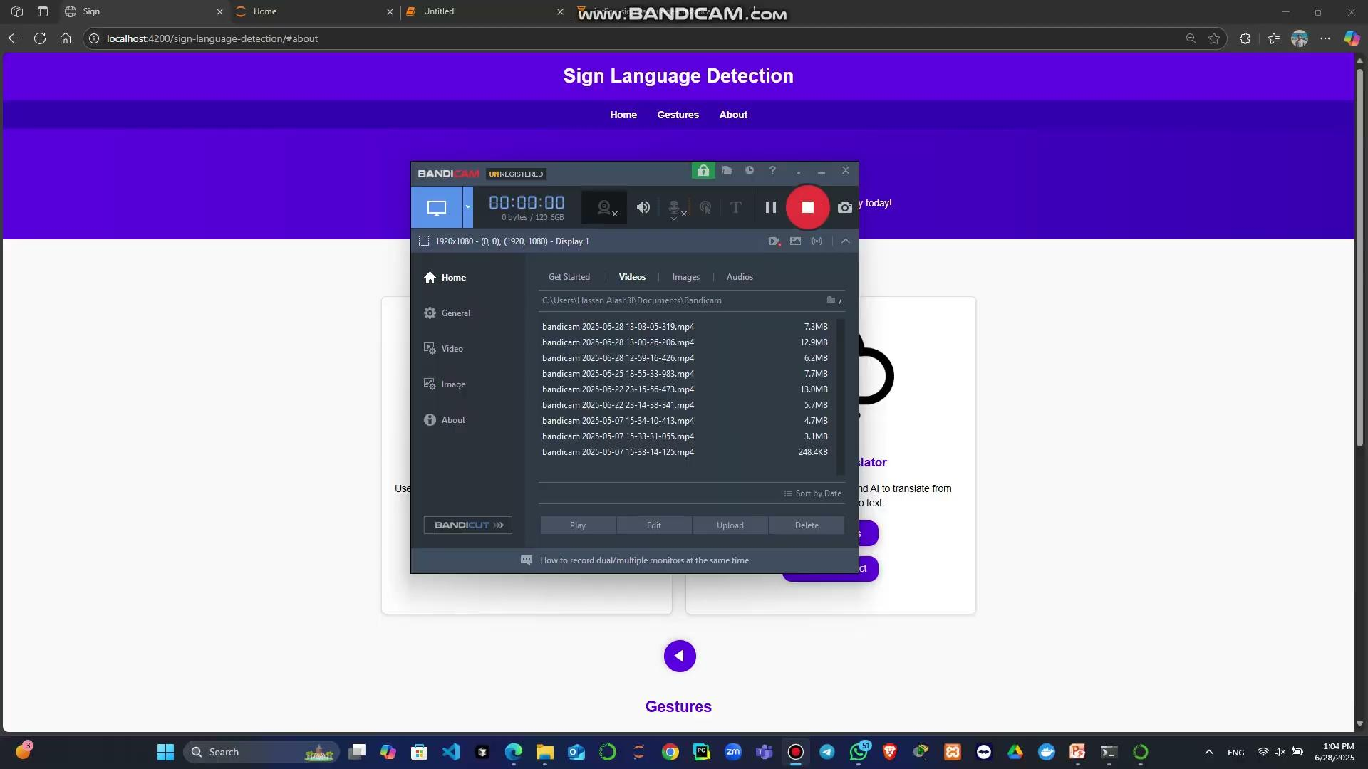

Slide 35
06 SECTION
What’s Next: Future Work & Vision

Slide 36
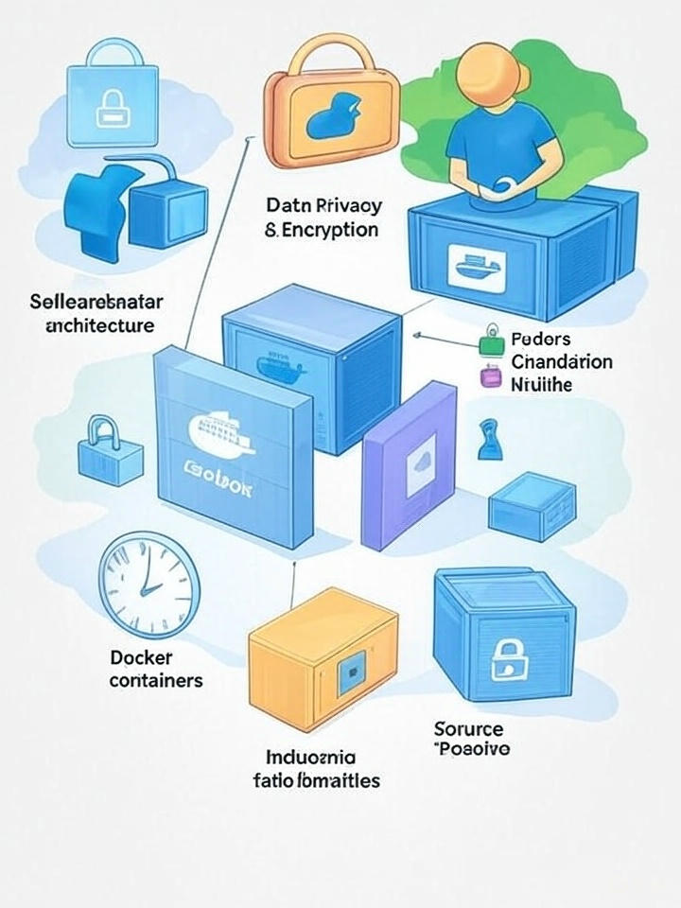
Future Technical Enhancement
JWT Authentication
Scalable Backend Architecture
Data Privacy & Encryption
Modular Codebase

Slide 37
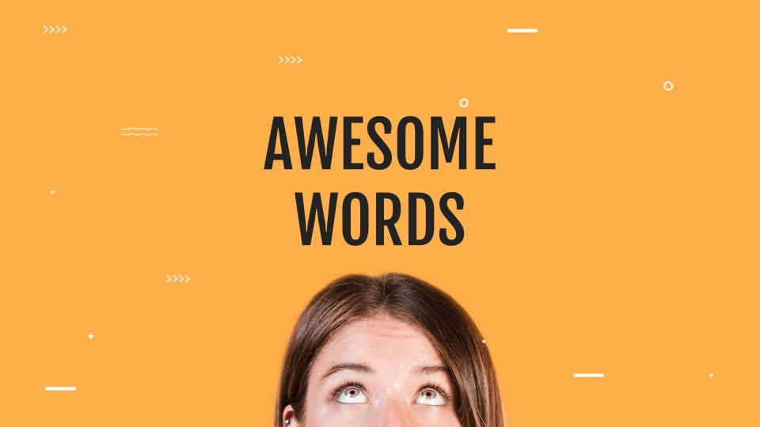
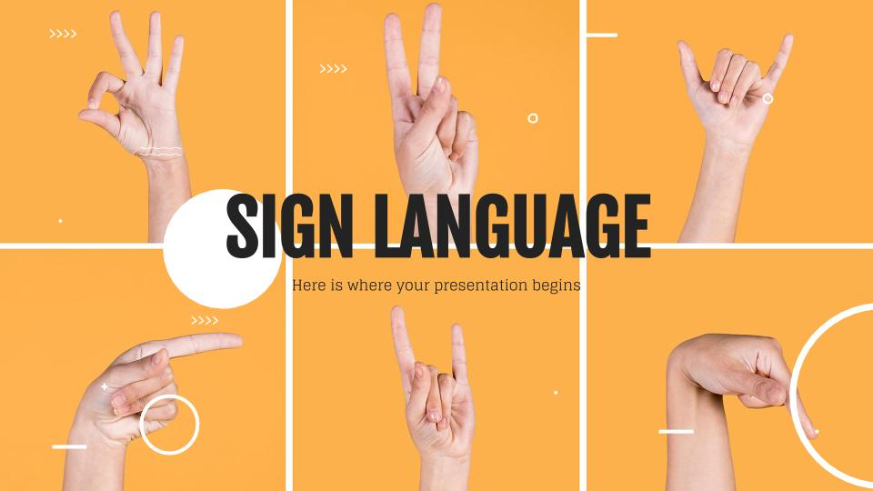
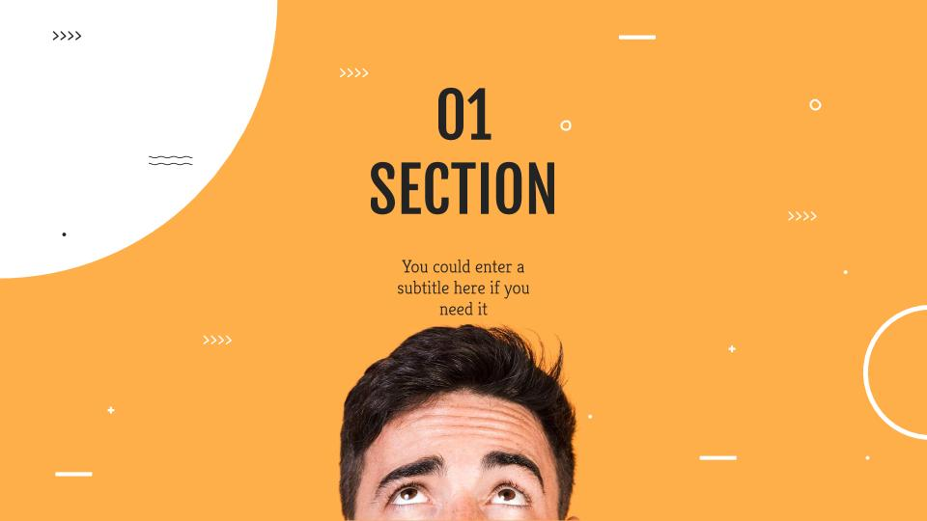
Our Goal: Make the System Available Across All Platforms

Slide 38
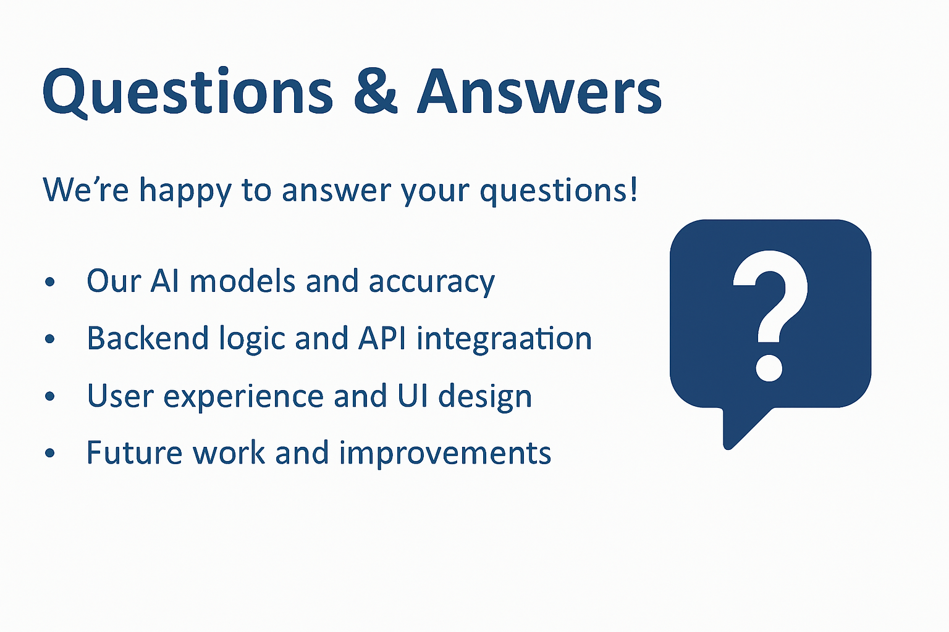
Questions & Answers

Slide 39
THANKS
Hassan Muhammed
Muhammed Salem
Abdulrahman Ahmed
Ziad Muhammed
Omar Ahmed
Yasser Dries
E-Mail:hassanmohamedyahoo68@gmail.com
E-Mail:MohamedSalemSoliman75@gmail.com
E-Mail:abdulrahmanahmed1662003@gmail.com
E-Mail:ziadmohamd333@gmail.com
E-Mail:omarraft37@gmail.com
E-Mail:edresyasser8@gmail.com

